Slide 1
Helping Musimorph content creators to generate more views, likes & subscribers
Presented By
BIBEK LAMSAL

Slide 2
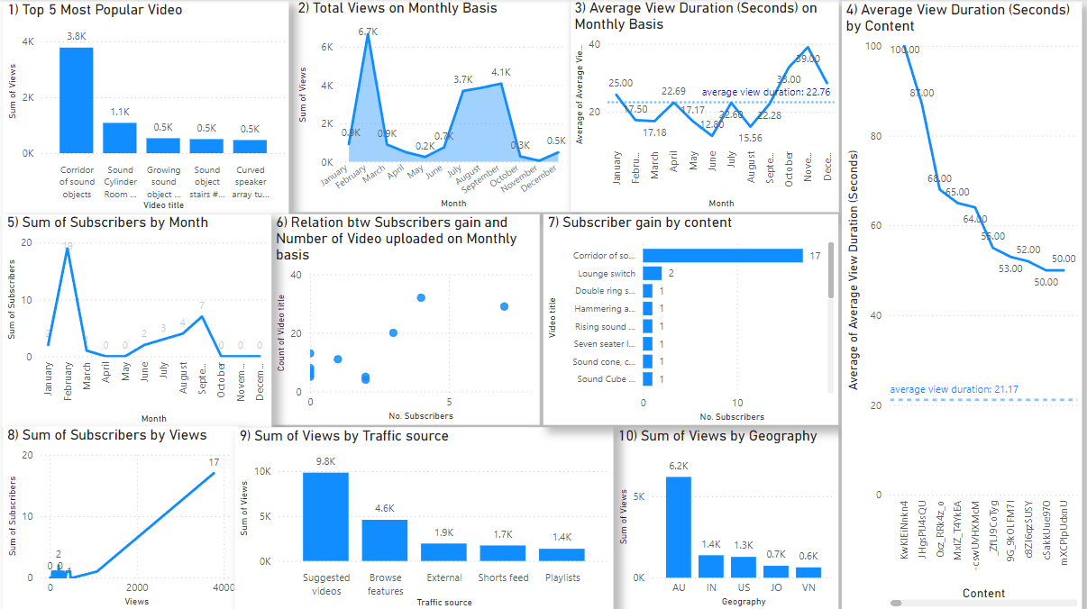
Visualization using dashboard

Slide 3
Insight:
Top Performer - Corridor of Sound Objects: This video is the standout performer with 3.8K views, dominating over others with less than 1.1K views. It also drove the highest subscriber gain.
Peak Activity Periods: February saw the highest views (6.7K) and subscriber growth, followed by a smaller peak in September (4.1K views). These suggest seasonal opportunities.
Traffic Sources: The majority of views came from "Suggested Videos" (9.8K) and "Browse Features" (4.6K). Lesser contributions from "Shorts" and "Playlists" suggest underutilized platforms.
Geographic Insights: Most views come from Australia, the US, and India, highlighting the need to create content customized for these regions.
Linear Growth Trend: Subscriber gains show a linear dependence on the number of views and content uploaded, emphasizing the importance of consistent publishing.
Seasonal Subscriber Trends: The "Sum of Subscribers by Month" chart indicates recurring seasonal growth patterns, which could align with audience behavior or specific campaigns.

Slide 4
Recommandation
Replicate Success of Popular Content: Create more videos similar to "Corridor of Sound Objects" by analysing its format, theme, and engagement strategy. Focus on producing content that resonates with your audience and drives both views and subscribers
Optimize for Suggested Videos: Since 9.8K views come from "Suggested Videos," enhance titles, thumbnails, and descriptions to improve click-through rates. Use keywords aligned with trending topics and related videos to leverage YouTube's recommendation algorithm.
Target Key Regions: Develop region-specific content for Australia, the US, and India by addressing local trends, interests, and cultural nuances. Include multilingual subtitles if applicable to appeal to diverse audiences and improve retention.

Slide 5
Call Through Action
Let's set a mee ting with the internet and content handling team to review and finalize the strategy for gaining more views and subscribers.

